Slide 1
What is Microsoft Azure?
Azure is a cloud computing platform which was launched by Microsoft in February 2010. It is an open and flexible cloud platform which helps in development, data storage, service hosting, and service management. The Azure tool hosts web applications over the internet with the help of Microsoft data centers.

Slide 2
Microsoft Azure are:
PAAS
SAAS
IASS

Slide 3
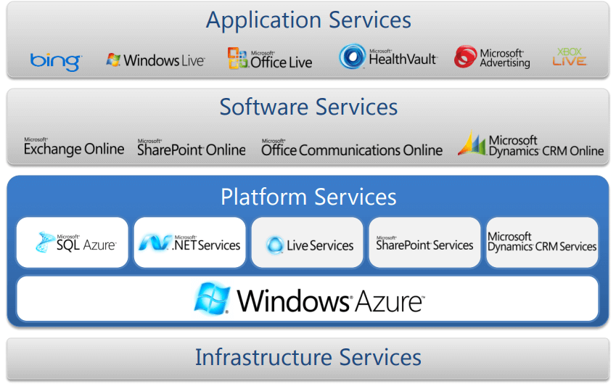

Slide 4
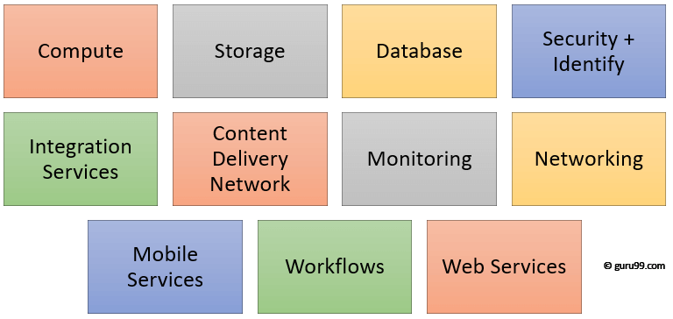
Azure Domains (Components)

Slide 5
Compute
It has the following components:
Virtual Machine
Virtual Machine Scale Sets: Allows you to create thousands of similar virtual machines in minutes
Azure Container Registry: This service store and manage container images across all types of Azure deployments
Functions: Let’s you write code regardless of infrastructure and provisioning of servers. In the situation when your functions call rate scales up.
Batch: Batch processing helps you scale to tens, hundreds or thousands of virtual machines and execute computer pipelines.
Service Fabric: Simplify microservice-based application development and lifecycle management. It supports Java, PHP, Node.js, Python, and Ruby.

Slide 6
Database
This category includes Database as a Service (DBaaS) which offers SQL and NoSQL tools. It also includes databases like Azure Cosmos DB and Azure Database for PostgreSQL. It has the following components:
SQL Database: It is a relational database service in the Microsoft cloud based on the market-leading Microsoft SQL Server engine.
DocumentDB: It is a fully managed NoSQL database service which is It built for fast and predictable performance and ease of development.
Redis Cache: It is a secure and highly advanced key-value store. It stores data structures like strings, hashes, lists, etc.

Slide 7
Storage
It has the following components:
Blob Storage: Azure Blob storage is a service which stores unstructured data in the cloud as objects/blobs. You can store any type of text or binary data, such as a document, media file, or application installer.
Queue Storage: It provides cloud messaging between application components. It delivers asynchronous messaging to establish communication between application components.
File Storage: Using Azure File storage, you can migrate legacy applications. It relies on file shares to Azure quickly and without costly rewrites.
Table Storage: Azure Table storage stores semi-structured NoSQL data in the cloud. It provides a key/attribute store with a schema-less design

Slide 8
Advantages of using Azure
cost-effectively enhance your business continuity strategy
Offers scalability, flexibility, and cost-effectiveness
You can deploy premium virtual machines in minutes which also include Linux and Windows servers
Helps you to scale your IT resources up and down based on your needs
You will not require processing power or hard disk space if you are using Azure

Slide 9
Disadvantages of Azure
Cloud computing is not possible if you can’t connect to the Internet
Azure is a web-based application which requires a lot of bandwidth to download, as do large documents
Web-based applications can sometimes be slower compared to accessing a similar software program on your desktop PC

